Slide 1

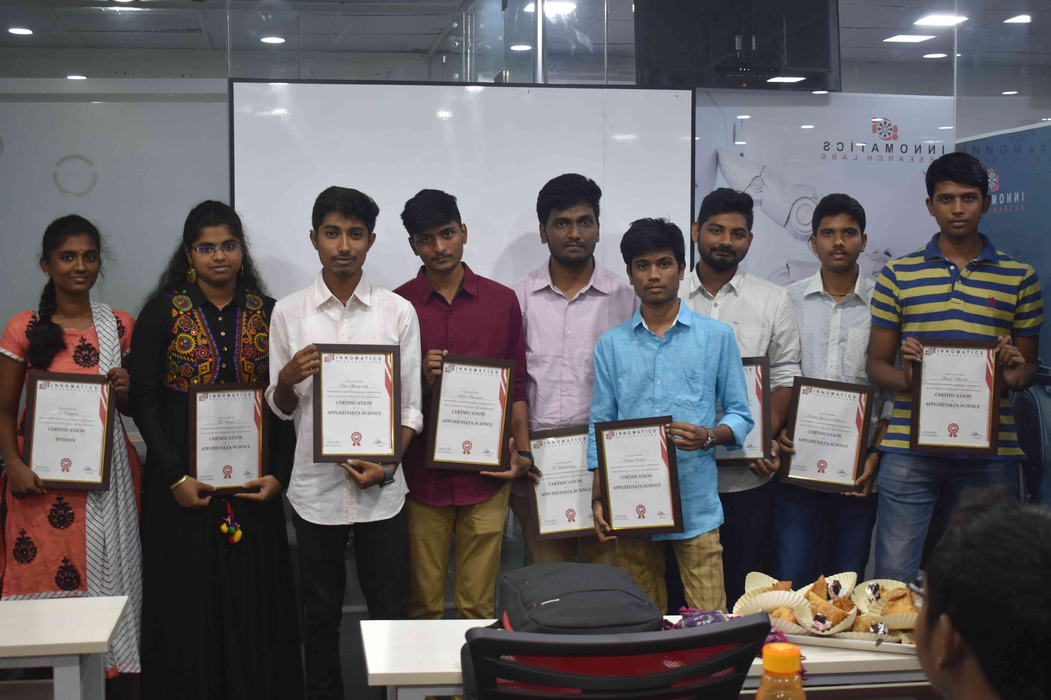
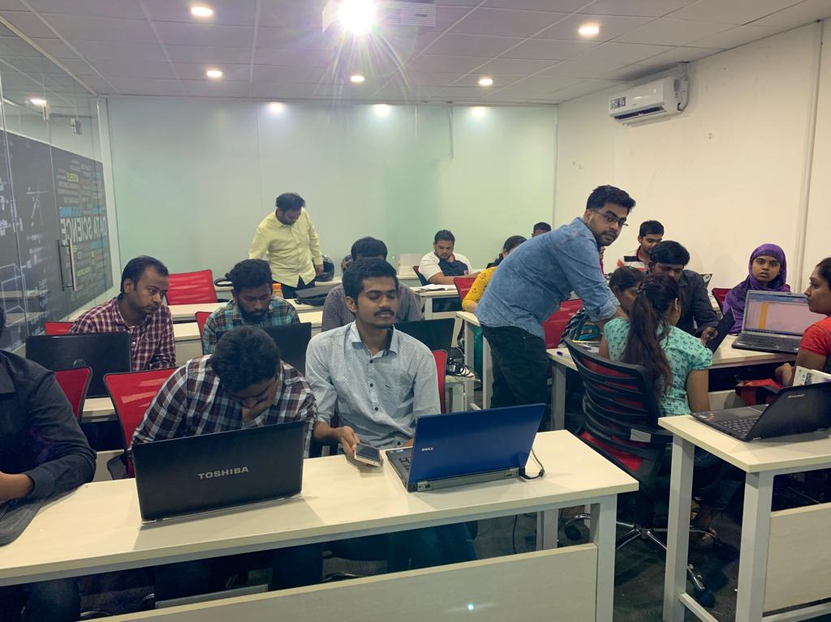

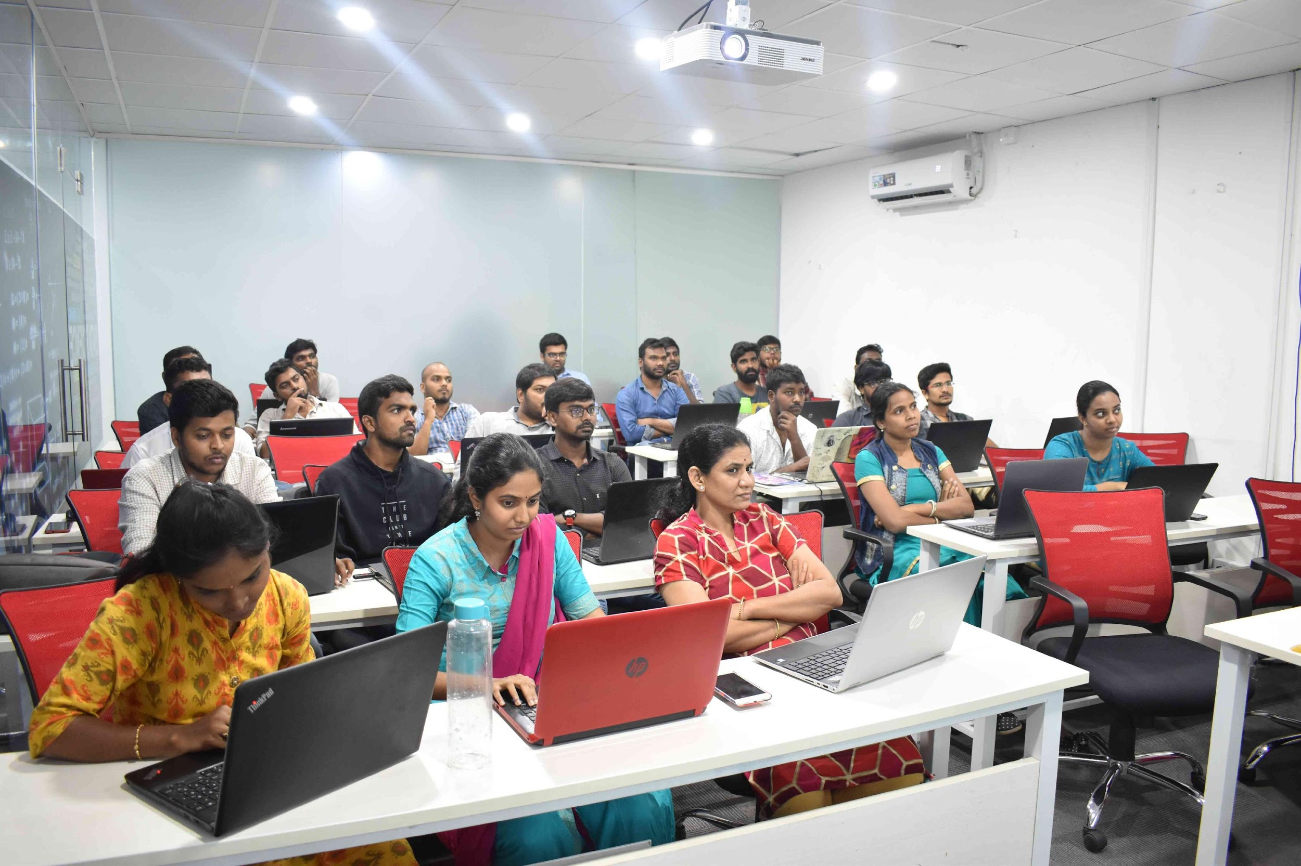
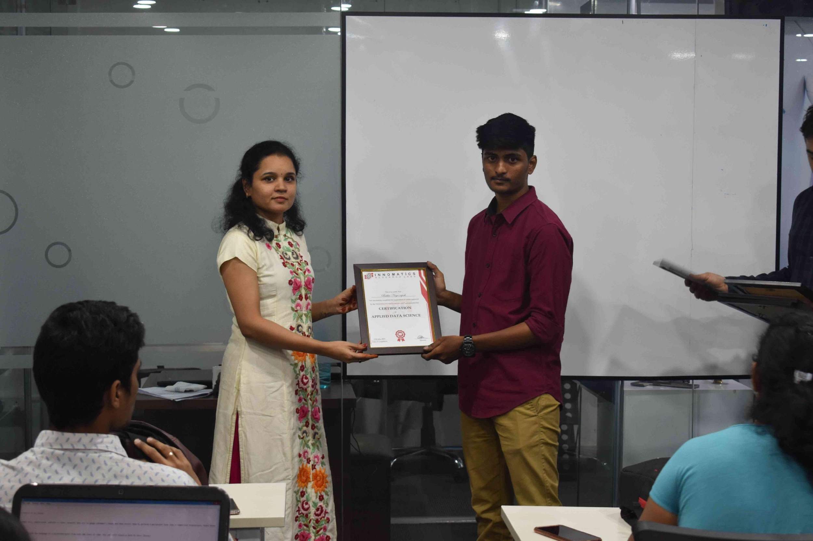
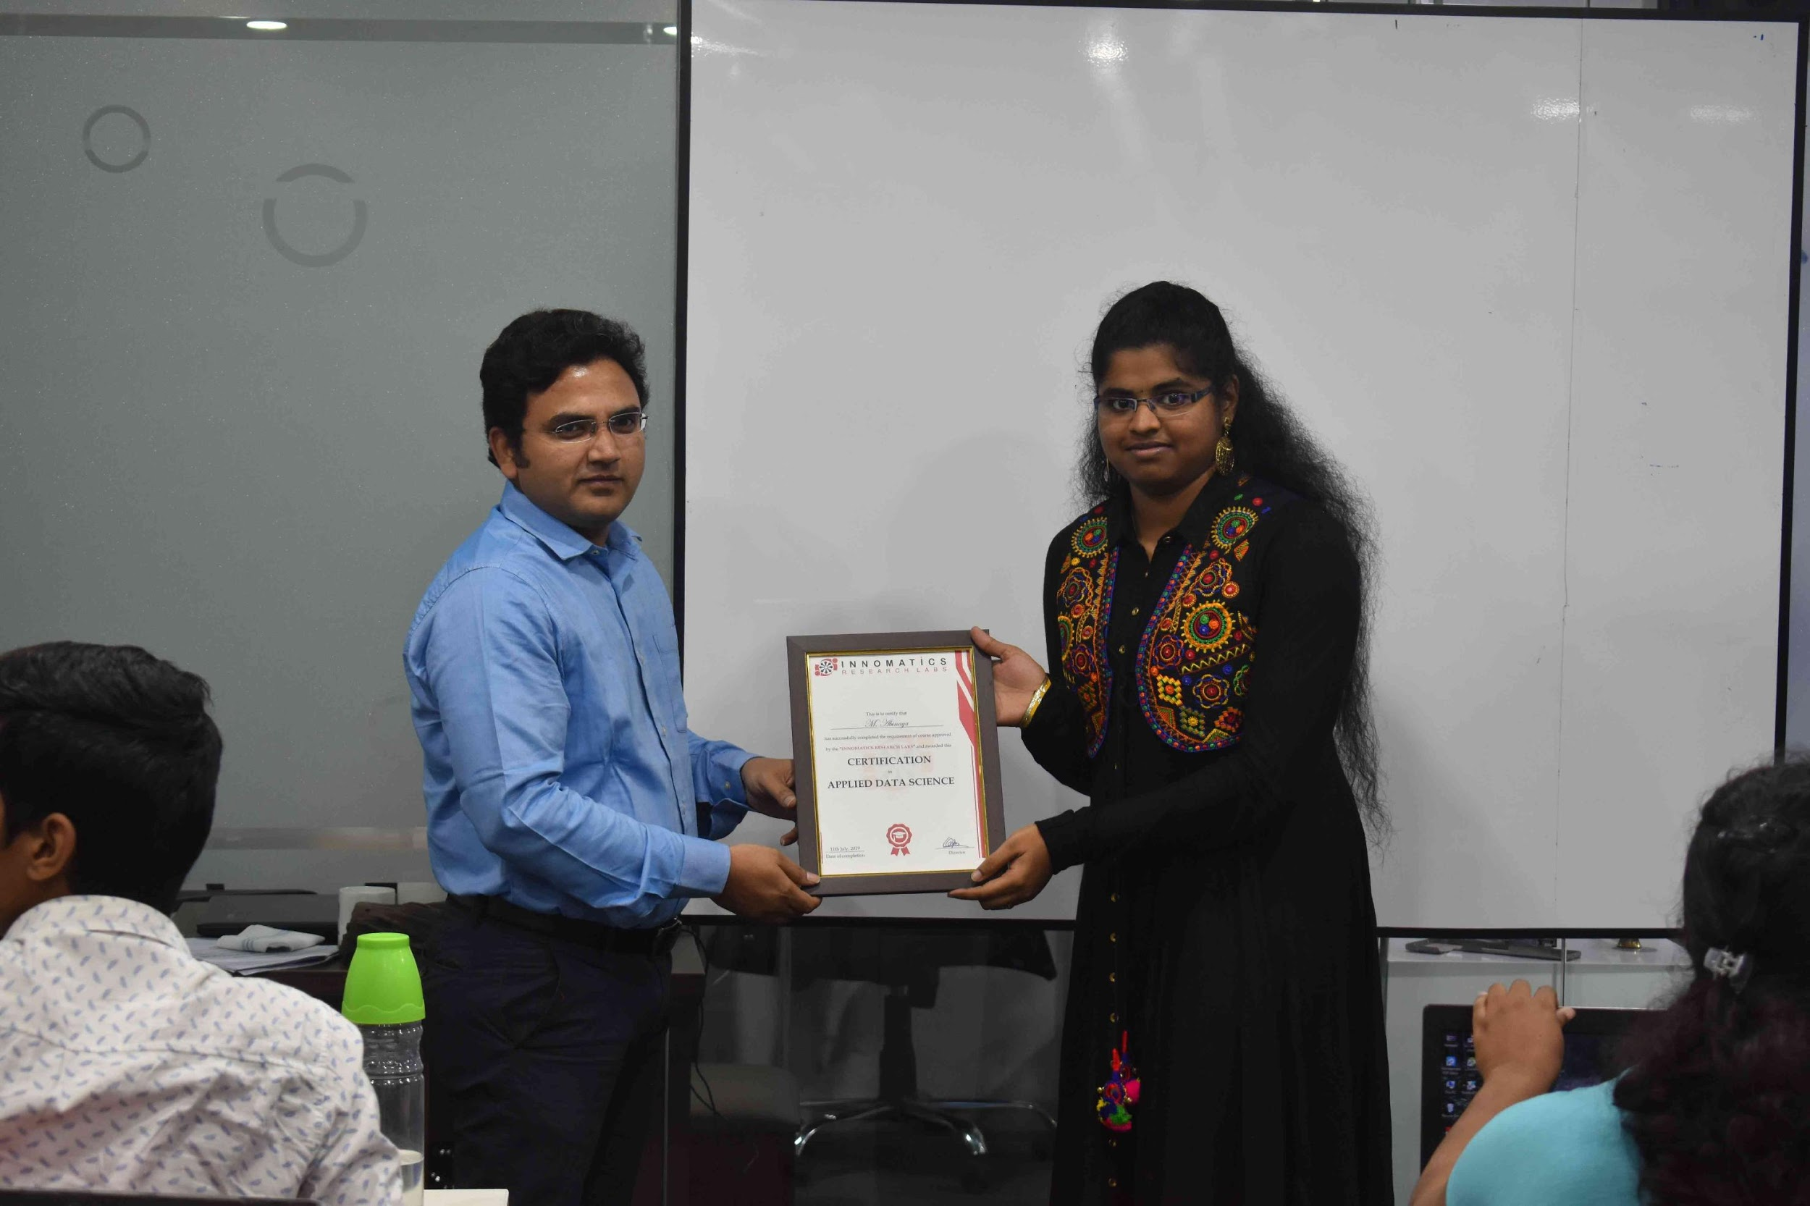

Slide 2
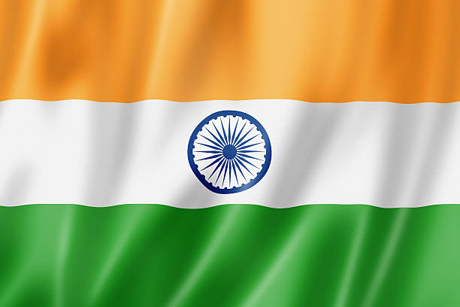
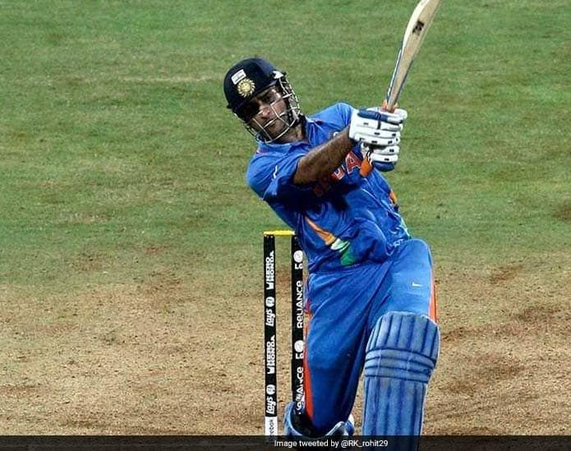
MS Dhoni International stats
Batch-147
Team members: 1)P. Chaithanya
2)P. Narendra kumar

Slide 3
Case
To gather all the international stats of MSD.
To find his favourite teams to bat
To find in which position he bats better
To get the better understanding of all records created by dhoni.

Slide 4

Website and method
Espncricinfo website has most of the information related to cricket.
https://stats.espncricinfo.com/ci/engine/player/28081.html?class=11;orderby=default;orderbyad=reverse;template=results;type=batting;view=innings
We have used read HTML to gather the items from the table and applied enumerate to give the indexes and gather the required table

Slide 5
Data cleaning
We have removed all the duplicates
Converted all the columns to desired datatypes
Created new columns using the different columns to analyse the data better.
Deleted the columns which are not useful for analysing the data.

Slide 6
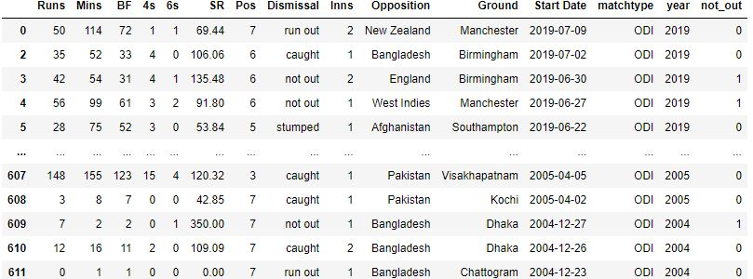
Data frame of Dhoni

Slide 7
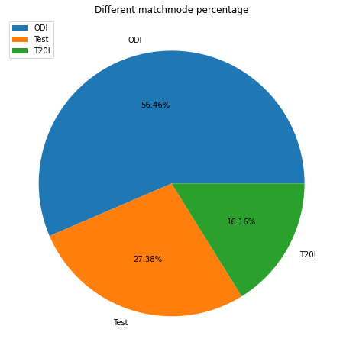
Percentage of match types played
He played more number of ODI matches when compared with test and T20I

Slide 8
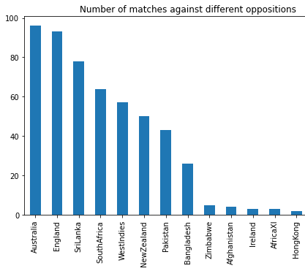
Number of matches played against different oppositions
He played more matches against Australia.
He played least number of matches against small cricketing nations.

Slide 9
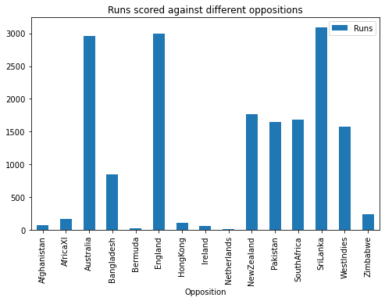
Sum of Runs scored against different oppositions
Most Runs scored against Sri Lanka, followed by England and Australia.
Least runs scored against small cricket playing countries

Slide 10
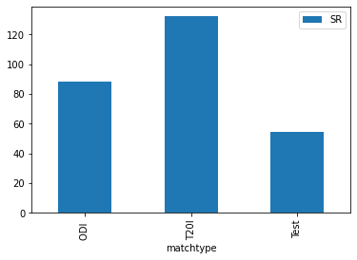
Strike rate in all match types .T20 strike rate is better which is above 130+

Slide 11
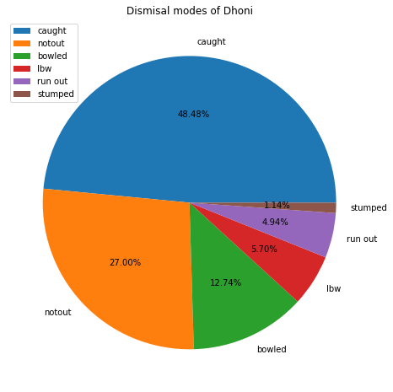
Dismissal modes percentage He was caught out most number of times. He has least number of dismissals through stumpings

Slide 12
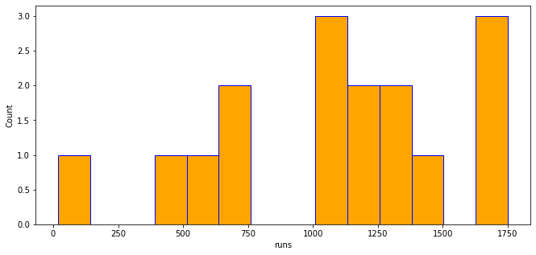
Frequency of runs Dhoni scored mostly between 1600 and 1750 in a year Surprisingly, Dhoni don’t have any runs between 800-1000 in a year

Slide 13
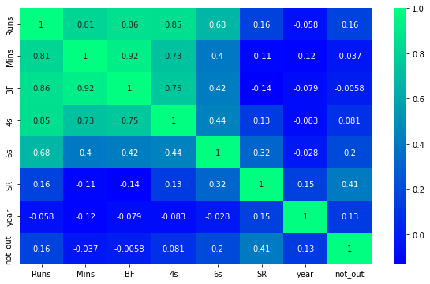
Correlation
There is strong relation between Runs and the minutes he stayed in the crease.

Slide 14
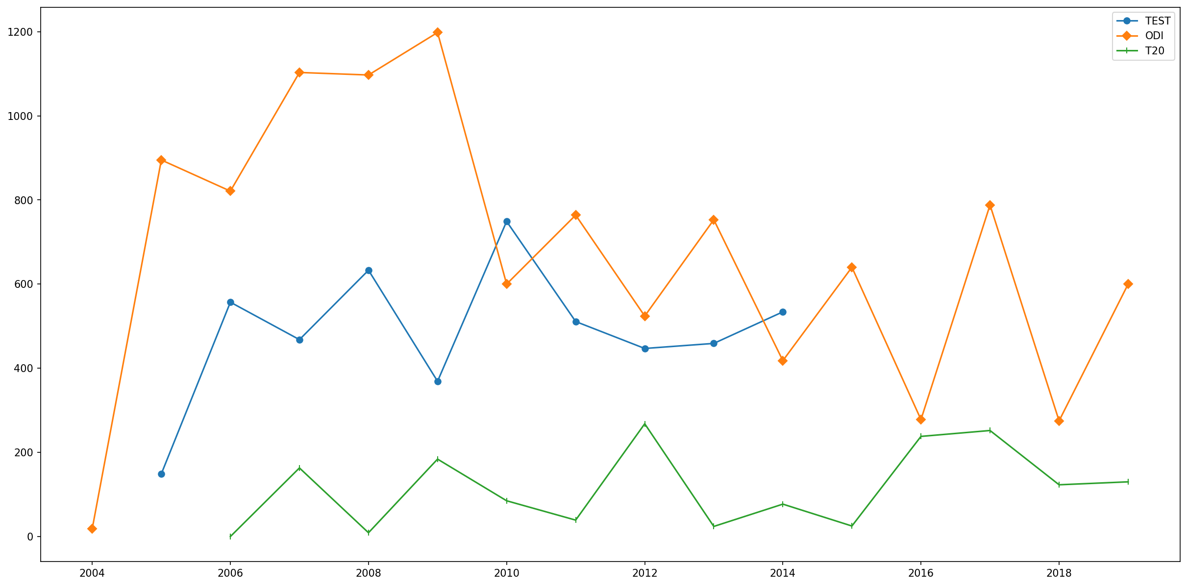
Runs in all three formats(2004-2019)

Slide 15
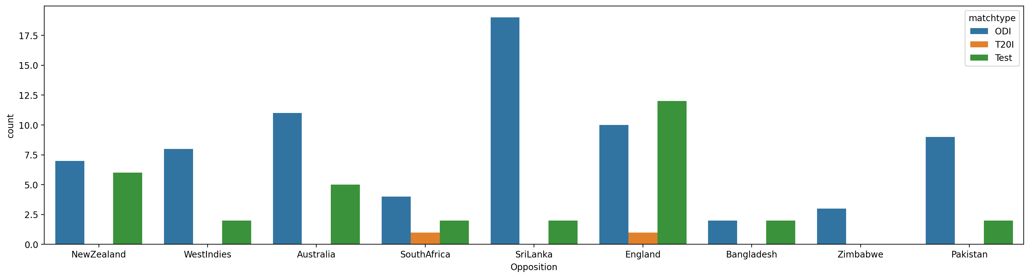
Number of fifties against different Oppositions
He scored most fifties against Sri Lanka in ODI
He scored more Test fifties against England

Slide 16
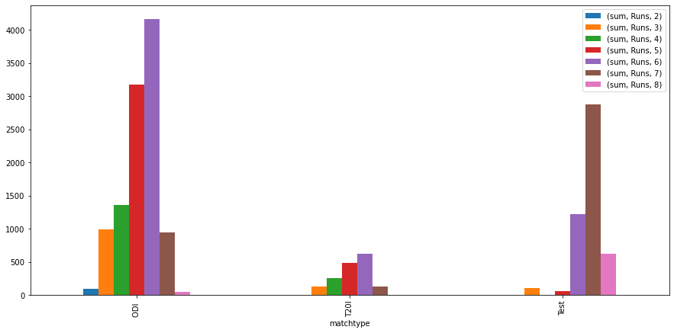
Runs scored at different positions
Dhoni has scored most runs batting at 6th position in ODI and T20I
He scored most runs at 7th position in Tests

Slide 17
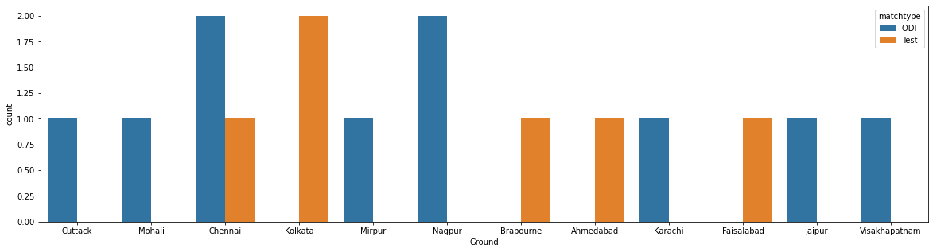
Centuries in different grounds
He has scored most centuries in India
He has only 2 centuries outside India

Slide 18
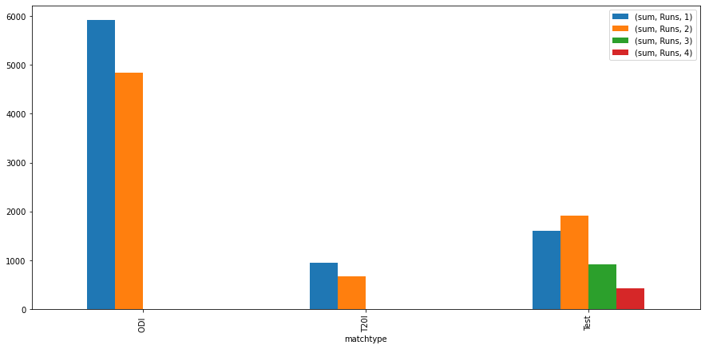
Innings comparison
He scored most runs while batting first
He plays good in 2nd innings of a Test match

Slide 19
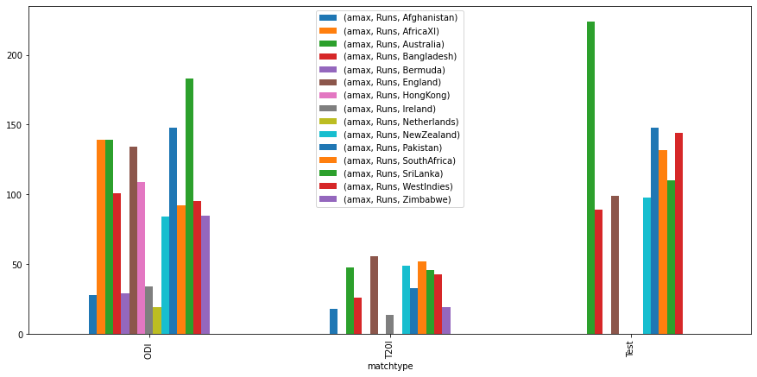
Highest individual runs among different teams
ODI-183-SRILANKA
Test-224- Australia
T20i-56-England

Slide 20
Challaneges faced
Cleaning the data was challenging as we need to get good visualisations.
Finding the best website with genuine information

Slide 21
Conclusion
Dhoni has scored more runs in ODI’s
He has scored most of the centuries in India
He was mostly dismissed through caught out
He likes to play against SriLanka, Australia and England.

Slide 22


